Slide 1

MOST EFFECTIVE URL VECTORS FOR FINDING MALICIOUS URLs AND PROPOSITION FOR A VOTING METHOD
SRM INSTITUTE OF SCIENCE AND TECHNOLOGY
FACULTY OF ENGINEERING AND TECHNOLOGY
DEPARTMENT OF NETWORKING AND COMMUNICATIONS
18CSP109L- PROJECT
Final Viva
13/5/2022
Student 1 Reg No: RA1811030010066
Student 2 Reg No: RA1811030010082
Batch ID: NCW066082
Guide Name: Dr. K. Kalaiselvi
Guide Designation: Assistant Professor

Slide 2

Table of contents
Introduction – Problem statement
Objectives
Literature Survey
Architecture diagram / Block diagram of the modules
UML Diagrams-ER diagrams/Use case diagram/Activity diagram (whichever is applicable)
Algorithms used
Software Used
Modules Description and implementation
Results and Discussion
Implementation screenshots (Appendix)
Paper Submission Status
References

Slide 3
Abstract
This paper consists of our research on machine learning models that would help us detect malicious URLs.
There are a variety of models available but we have taken CNNs and Basic ML models along with URL vectors and features, because using RNNs or CNN LSTMs is not feasible for our data because we are already extracting features and then the CNN trains itself on them.
The main highlights of our thesis have been that the accuracy measures of the our main algorithms have differed but the time processing factor made us propose a fusion of three models.
We came across different research papers and realize that different models recognize URL features differently. Thus a fusion was proposed.
Our research has also led us to find the most important URL vector which we came across while testing different databases.

Slide 4
Introduction
The world has seen immense development in the field of Internet technology which in turn with its many benefits has caused some problems as well and the biggest being - diverse threat to the network security.
Attackers have been found spreading malicious Uniform Resource Locators (URLs) to initiate attacks like phishing, spam and financial fraud for gathering sensitive information or capital. The prevention of malicious URL attacks requires more research to be performed for the accurate and efficient detection.
Popular types of attacks using malicious URLs include: Drive-by Download, Phishing and Social Engineering, and Spam. Drive-by download refers to the (unintentional) download of malware upon just visiting a URL.
Such attacks are usually carried out by exploiting vulnerabilities in plugins or inserting malicious code through JavaScript. Phishing and Social Engineering attacks trick the users into revealing private or sensitive information by pretending to be genuine web pages. Spam is the usage of unsolicited messages for the purpose of advertising or phishing
Previously techniques like blacklisting regular expression and signature matching were applied but they were ineffective and inaccurate.

Slide 5
A Kaspersky Catalogue from 2020 tells us that 85% of threats on the web were due to disinfected URLs. Around ⅓ of all existing URLs are found to be malicious in another research.
Malicious URLs have been deemed the major factor in online security threats. Attackers can gain backdoor access to sensitive data by just sending one well disguised URL to an innocent person. Malicious URLs are the weapon of choice in Cyber Attacks [1].A survey shows that 75% of ransomware infected companies were using up to date protection systems.[2]
Blacklisting methods are fast but they are again outdated in the era of ever evolving internet.In our previous research project we analyzed various models to detect Malicious URLs and compared their accuracies. Extending the project and its implementation we faced time boundings in the traditional CNN model but we did gain a stellar accuracy with this character embedded CNN model.
Moving on we thought of finding of the URL features that are important or rather more relevant to the malicious or benign prediction, following through on this we proposed creating a voting algorithm that utilized all the other algorithms that we used before and also performed the same procedures by not including some URL features to find if they are more relevant that the others or not.

Slide 6
Motivation
Our motivations were derived from the following needs:-
75% of the world’s organisations witnessed phishing attacks in 2020 only.
96% of phishing attacks arrive by emails containing a malicious URL.
These attacks further cause a lot of damage to society. Some attacks may install spyware, ransomware etc. India saw a huge incline in ransomware based attacks in 2020 and was the 6th most affected country in the world.
Trend Micro Incorporated announced that it blocked 40.9 billion email threats, malicious files and malicious URLs for its customers worldwide in the first half of 2021. The present detection technique of blacklisting in a database fails at detecting new variations of malicious URLs. The shortened versions of the URLs (bit.ly) are not checked because they do not reveal the destination.
We plan to develop a deep learning model that can overcome these problems and effectively start detecting new and varied versions of URL attacks. We will extract in-depth lexical features from URL strings namely – lexical features, content-based and host-based features.

Slide 7
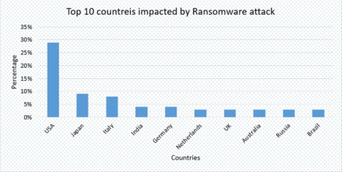
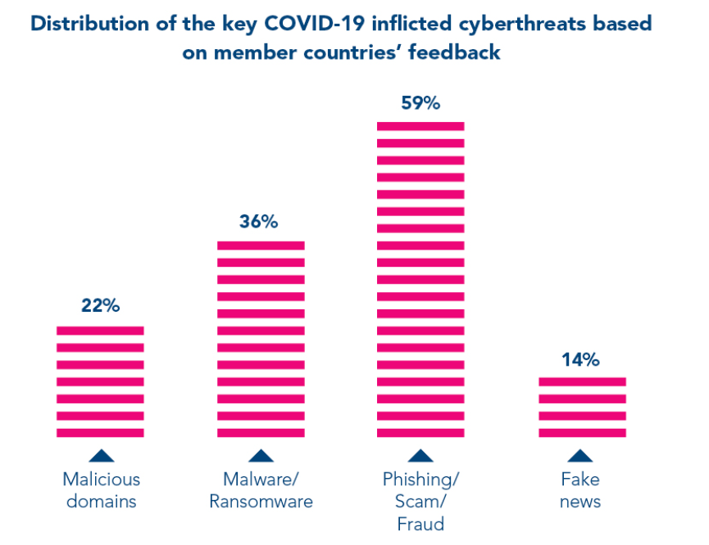

Interpol summary report

Slide 8
Objectives
The purpose of this project is –
Conducting a research study on existing models to ensure safe navigation and to minimize network security shortcomings.
Provide an add-on and a website deployed on the web for url classification.
Database creation and maintenance for storing each and every Malicious URL that is encountered.

Slide 9
Literature Survey
Year: 2021
Author: Shantanu Maheshwari, Janet B , Joshua Arul Kumar R
Title: Malicious URL Detection: A Comparative Study
Methodology:
Feature extraction techniques like LDA and PCA are used to extract features and then along with NLP the model is trained. Various machine learning models are then compared
Advantages:
The various ML models are utilized which helps us get an idea of accuracies for the different models
Shortcomings:
The common techniques of feature extraction are used like LDA and PCA where we hope specific URL features may give us a better accuracy

Slide 10
Literature Survey
Year: 2020
Author: Cho Do Xuan, Hoa Dinh Nguyen, Tisenko Victor Nikolaevich
Title: Malicious URL Detection based on Machine Learning
Methodology:
The deep learning model is trained on URL features and then is used for classification
Advantages:
URL features like host based features, lexical features are used which help in a better method of feature extraction
Shortcomings:
Only a single model of machine learning is employed

Slide 11
Literature Survey
Year: 2021
Author: Vinayakumar R, Sriram S, Soman KP, and Mamoun Alazab, Senior Fellow, IEEE
Title: Malicious URL Detection using Deep Learning
Methodology:
Deep Learning with Character Level Embedding is used for malicious URL detection
Advantages:
Deep Learning and Neural Networks are used
Shortcomings:
URL features like host based, lexical features and suspicious keywords
are not involved.

Slide 12
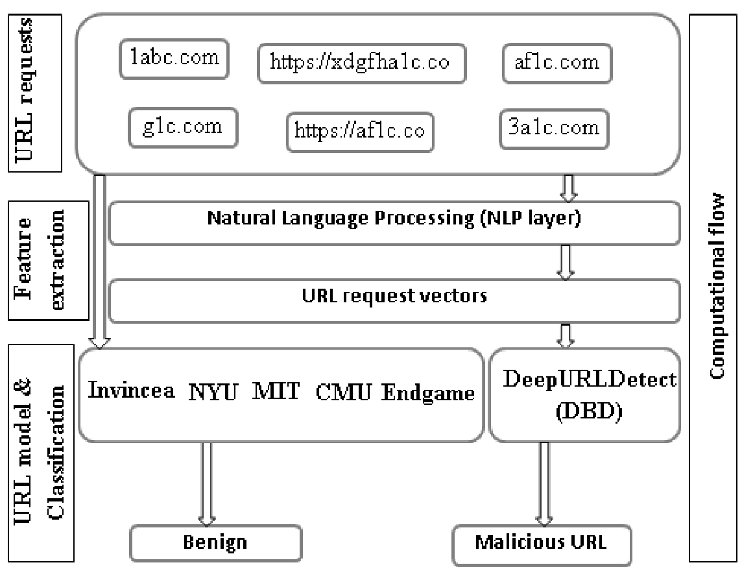
srmist.com academia.com sbi.net
googleforms.com blog.paperspace.com
cricstream.me
URL Vectors like lexical features, host based etc

Slide 13
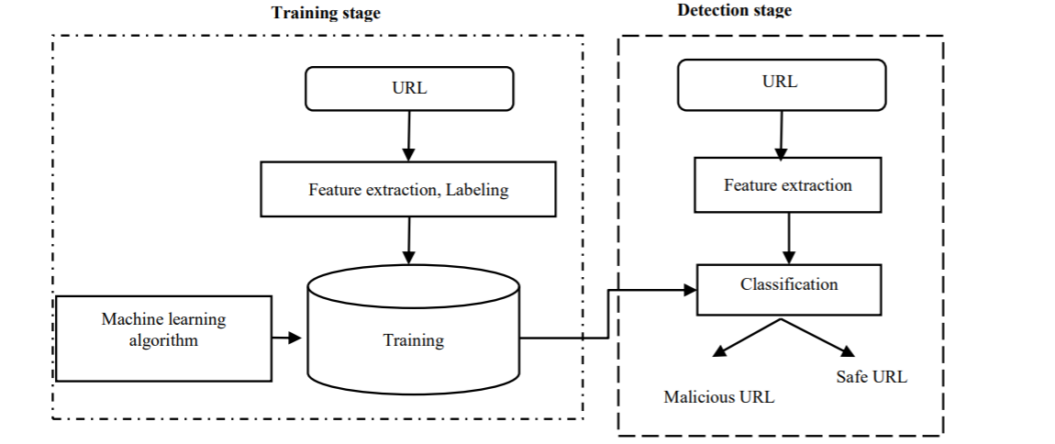
Chosen Machine Learning technique
Fig: Algorithm Workflow

Slide 14
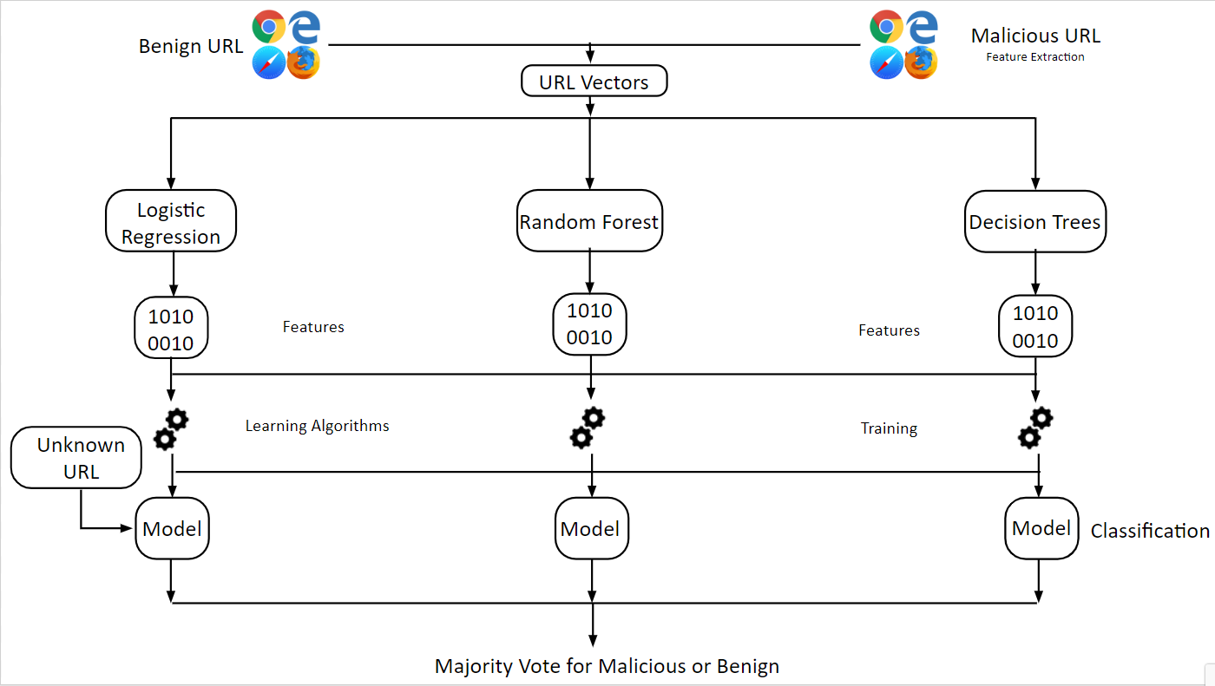
Fusion System Diagram

Slide 15
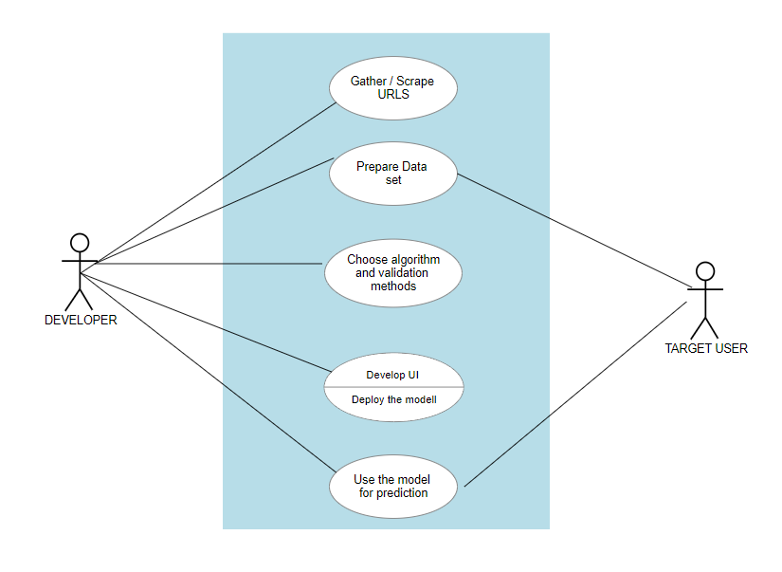

Slide 16
Algorithms/Tools Used
1) Logistic Regression :-
Logistic regression is a statistical analysis method used to predict a data value based on prior observations of a data set.
2) Random forest Classifier :-
Random forest is a supervised ML model which basically uses decision trees and then takes as a vote/average for classification/regression.
Here the accuracy is increased due to the combination of multiple classifiers. Also, the training time is lesser in random forests model.
3) Decision Trees Classifier :-
Decision Trees are the only supervised learning machine algorithm that can be used both for classification and regression.

Slide 17
Their structure matches a lot with the classic Data Structure Trees, which consist of internal and leaf nodes and a root node.
Decision tree learning employs a divide and conquer strategy by conducting a greedy search to identify the optimal split points within a tree. This process of splitting is then repeated in a topdown, recursive manner until all, or the majority of records have been classified under specific class labels.
4) CNNs :-
CNNs are deep learning algorithms where the images/data fed to the input layer are assigned
importance in terms of biases/weights and then these features are learnt to recognize their
importance in the given data.
We have used character level embedding here to use CNNs for text level filtering.

Slide 18
Software Used
Jupyter Notebook
Python
Data Handling Tools-
Pandas
Matplotlib
Seaborn
Machine Learning Tools -
Keras
Tensorflow
Star UML

Slide 19
Modules Description
Database Gathering & Collection - A pool of URLs with specific tags from kaggle and other web scraped urls which will be used to train our model.
Data Engineering - It involves analysing, preprocessing, extraction of features and data cleaning, normalisation and encoding
Model Training & Testing - A variety of algorithms are used to train our model and its tested on the validation data to obtain various parameters.
Model Comparison - The accuracies for different models are obtained and the best one is selected.

Slide 20
Modules Description
5)Model deployment - The combination of selected models and blacklisting processes which would work on a double fast and slower layer model is then deployed along with UI on a cloud server which is now ready for the world to test.
6) Voting System Model -This was our proposed system which utilizes 3 algorithms and improves upon the accuracy, and is still lightweight.

Slide 21
Modules Description - Model 1 CNN
A CNN is a deep learning algorithm which uses artificial neural networks with different layers. Filters are applied to input layers and an activation is obtained.
CNNs take inputs, assign importances via biases and weights and then develop differences between the inputs in our case which are URLs.
Convolutional Neural Networks (CNNs) are similar to ANNs and contain neurons which optimize according to self learning. Each neuron will still receive an input and perform an operation.
The CNN model is used first and the predictions and validations are made against the 20% of data.

Slide 22
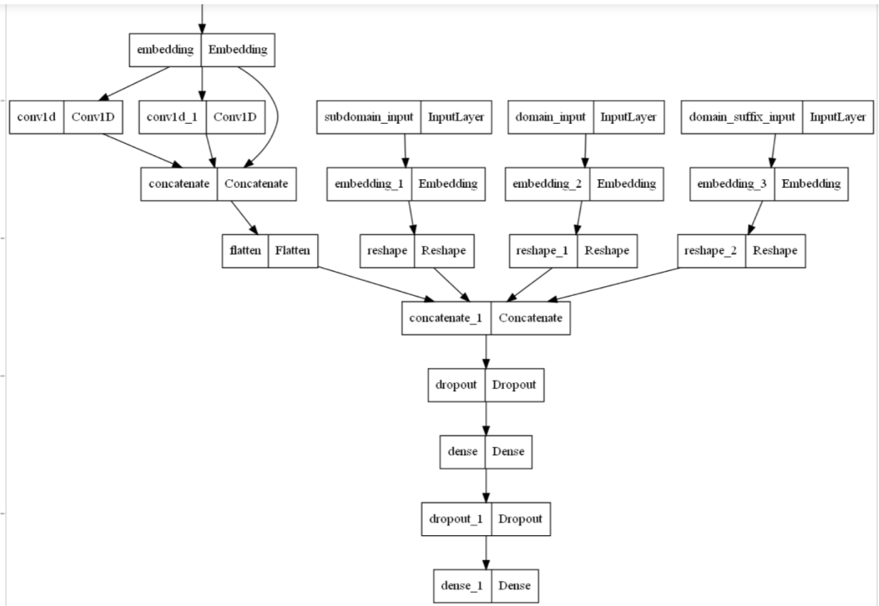

Slide 23
Model 2 URL Vectors
Features must be extracted from URLs to obtain vectors.
URLs constitute basically two types of features: -
Host Based Features
Content Based Features
Lexical Features
Host based Features -
Host Based Features as the name suggests are characteristics derived from host-names. Hackers started utilizing the exploits that come through with short urls, and the Time To Live was very less for URLs to be detected and classified. These provide other information like webpage, ports, connection speed etc.
Content Based Features-
These are the features associated with the download of the webpage/
They are obtained from HTML and JavaScript information but these features require a lot of extraction.

Slide 24
Lexical Features
These are the features derived from the name of the URL. It covers how the URL manifests or displays itself in public, and many harmful URLs may try to impersonate the benign ones. These may be combined with host based features to improve model performance and score.
Statistical information in the URL counts as a part of lexical features. Features like token counts in domain name, path name, longest/average domains or paths, special characters used are compiled into a dictionary where each word is a feature. Presence and absence are indicated via 0 or 1.
Entropy is another feature which measures the randomness of a domain name. Some Malicious URL obfuscation methods utilize Domain Generation Algorithms, which manipulate the urls consistently. Thus by setting limits on URL entropy helps govern URL legitimacy.
Sensitive words are also extracted as a part of lexical features (login, sign in, secure etc.)
In recent times, researchers have found advanced lexical features to be useful when calculated with significant heuristics in mind.
Kolmogorov Complexity defines some advanced features that concentrate on - URL related, Domain related(length, IP etc.), Directory Related, File names and Argument features.

Slide 25
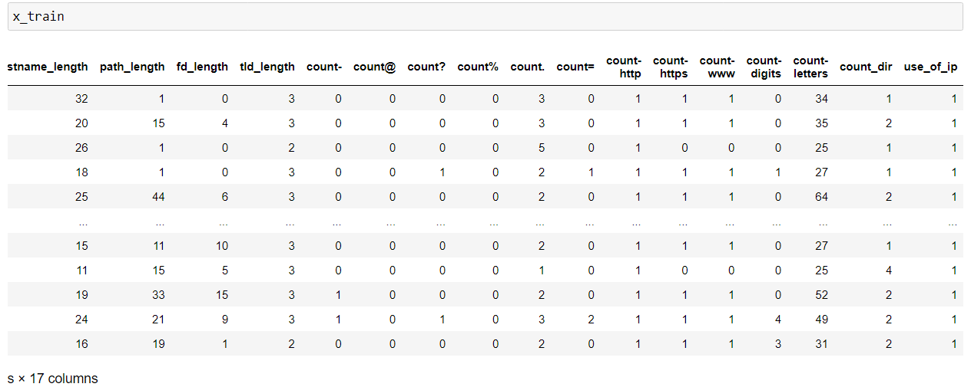
Modules Description - Model 2 URL Vectors
Seventeen different URL Vectors have been utilised from the dataset used for training the model.

Slide 26
The following features will be extracted from the URL for classification.
Length Features
Length Of Url
Length of Hostname
Length Of Path
Length Of First Directory
Length Of Top Level Domain
Count Features
Count Of '-'
Count Of '@'
Count Of '?'
Count Of '%'
Count Of '.'
Count Of '='
Count Of 'http'
Count Of 'www'
Count Of Digits
Count Of Letters
Count Of Number Of Directories
Binary Features
Use of IP or not
Use of Shortening URL or not
Apart from the lexical features, we will use TFID - Term Frequency Inverse Document as well.

Slide 27
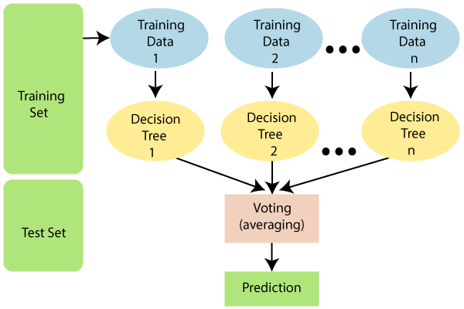
Model 3 - Random Forest Classifiers
Random forest classifier takes various subsets of the supplied dataset and passes them through a number of decision trees culminating the average of the trees to arrive at a prediction.

Slide 28
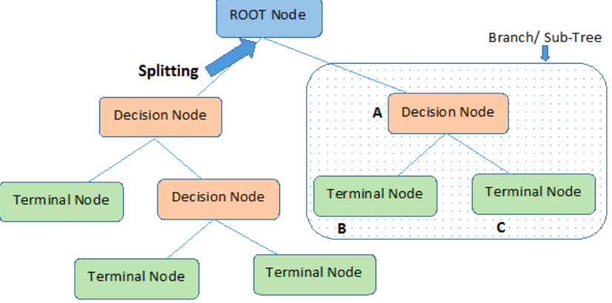
Model 4 - Decision Trees
Decision tree works on the concept of learning rules inferred from the previously supplied data and then making decisions on the supplied data.

Slide 29
Using Decision Trees and Random Forest classifiers

Slide 30
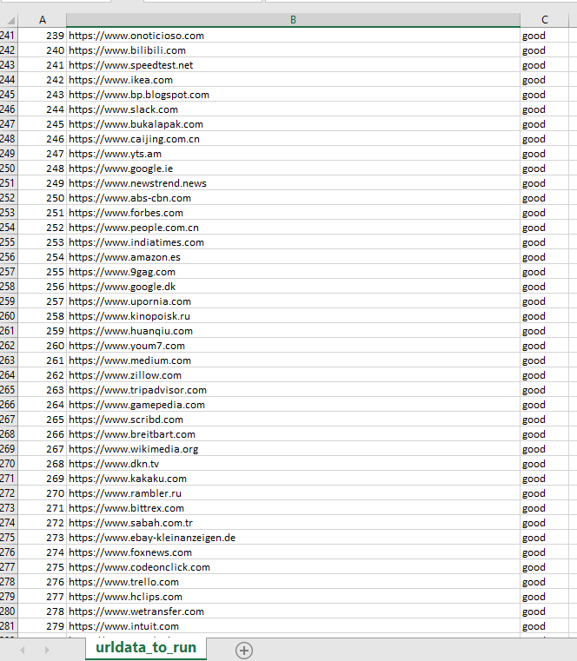
Module 1 - Data Gathering and Collection
We’ve obtained and compiled the dataset from various sources like -
kaggle, web scraping and sites from Cyber Security institutes.
https://www.unb.ca/cic/datasets/url-2016.html

Slide 31
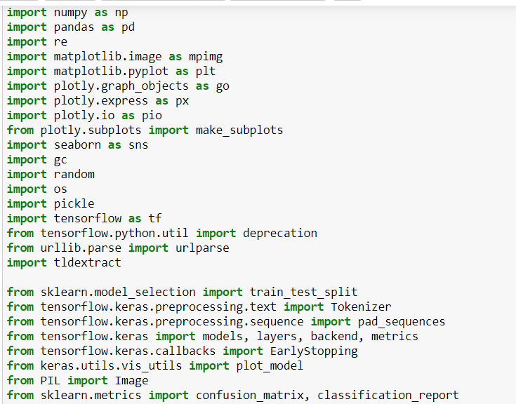
Module 2 - Data Engineering (Libraries Used)
These are the modules we mainly used for both of our models and datasets

Slide 32
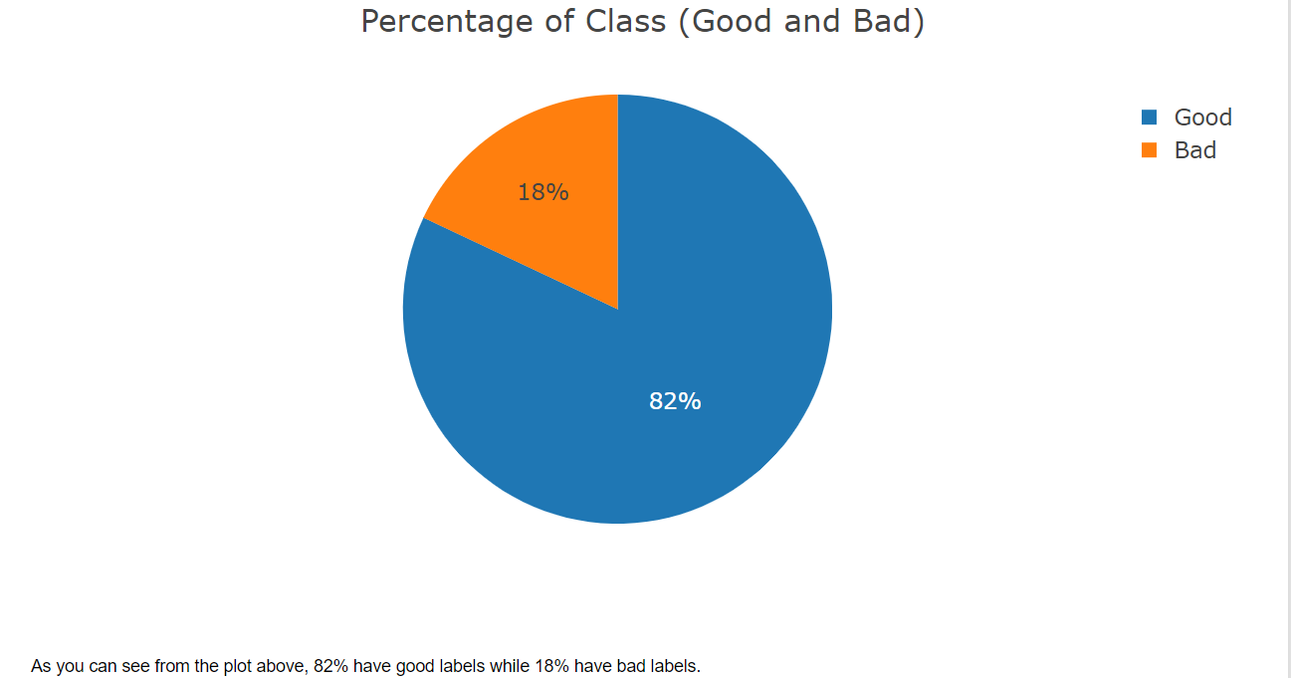
Module 2 - Data Engineering (Data Range)
Here’s the ratio taken for good and bad urls.

Slide 33
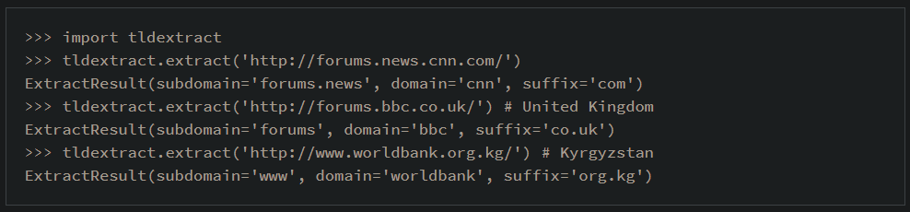
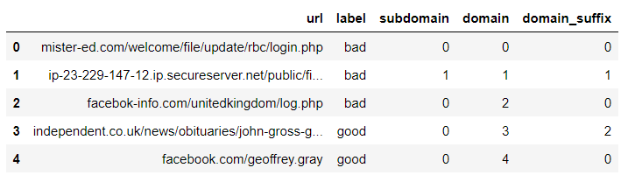
Module 2 - Data Engineering
After using the functions we’ve made like parsed_URL and extract_URL we along with the python module tldextract, we obtain and convert the dataset in this form.

Slide 34
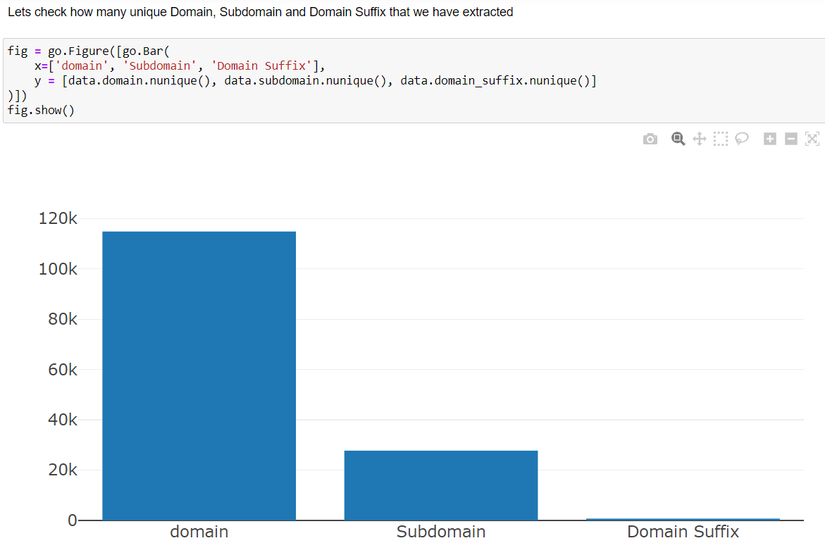
Module 2 - Data Engineering

Slide 35
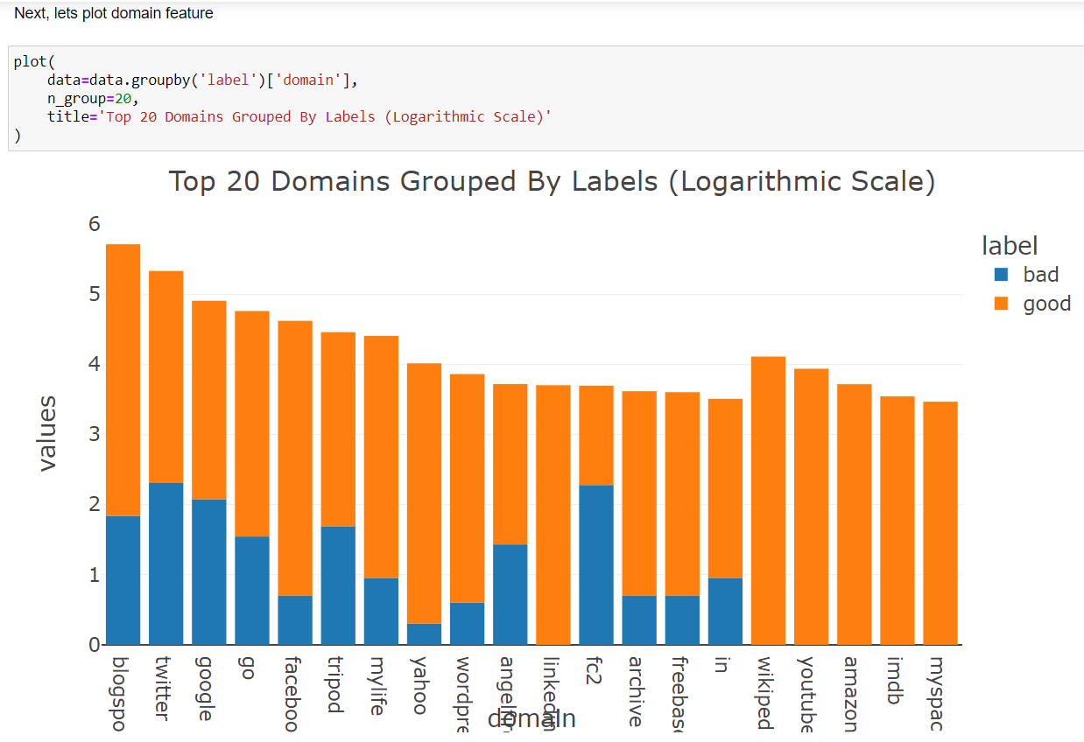
Module 2 - Data Engineering

Slide 36
Module 3&4 - Training and Comparison
We use model.fit from keras to train the model and then we have set the early stopping parameter as 5 epochs or iterations after which we end the training.
The parameter spectates the value of val_precision here in the “monitor=”argument.

Slide 37
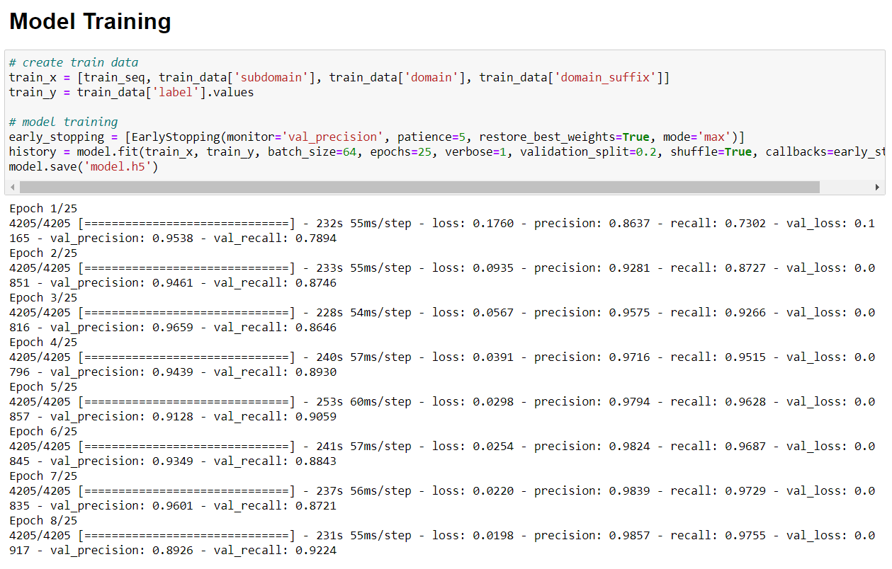
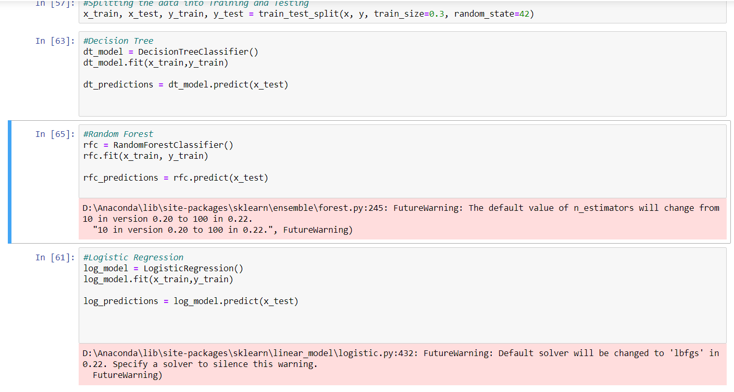
Module 3&4 - Training and Comparison

Slide 38
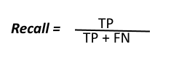

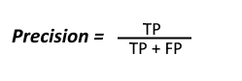
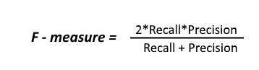
Appendix 1 - Evaluation metrics
Confusion Matrix

Slide 39
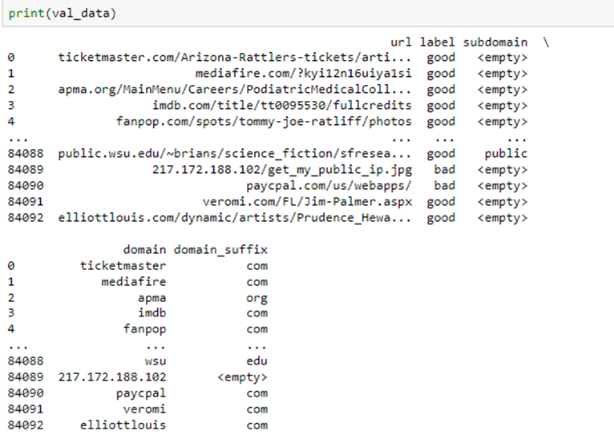
Implementation & Code
After the basic extraction of domain, Subdomain and suffixes we filtered our dataset as follows

Slide 40
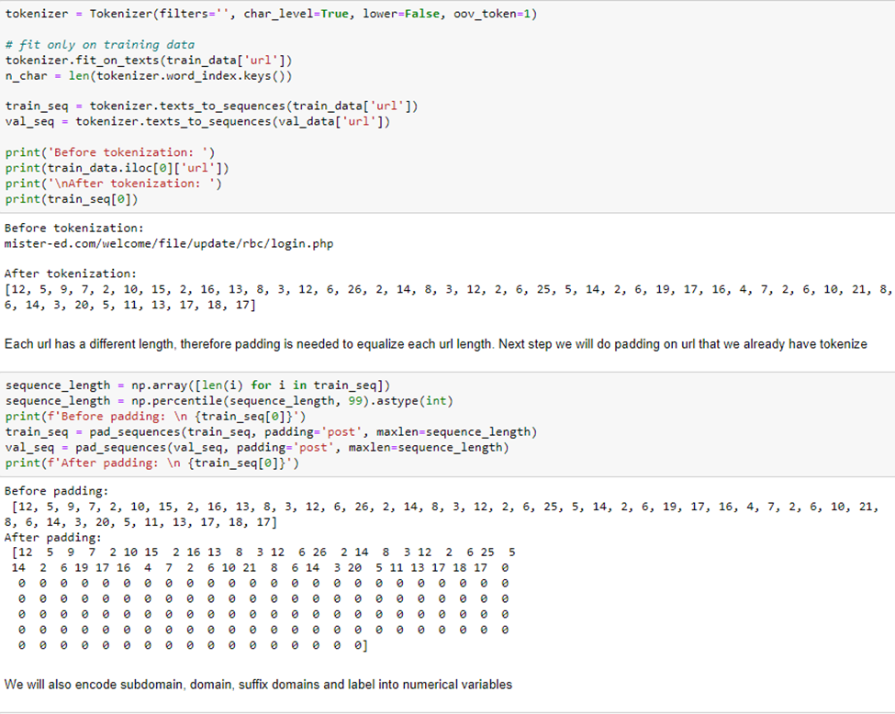

Slide 41
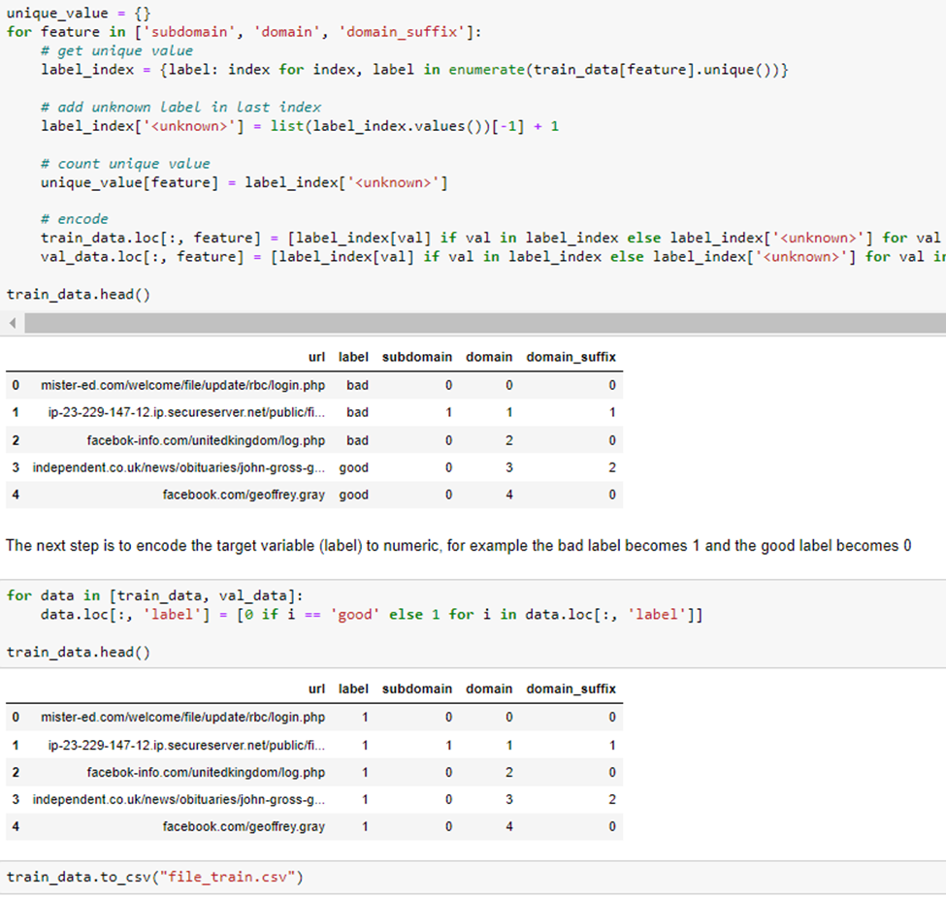

Slide 42
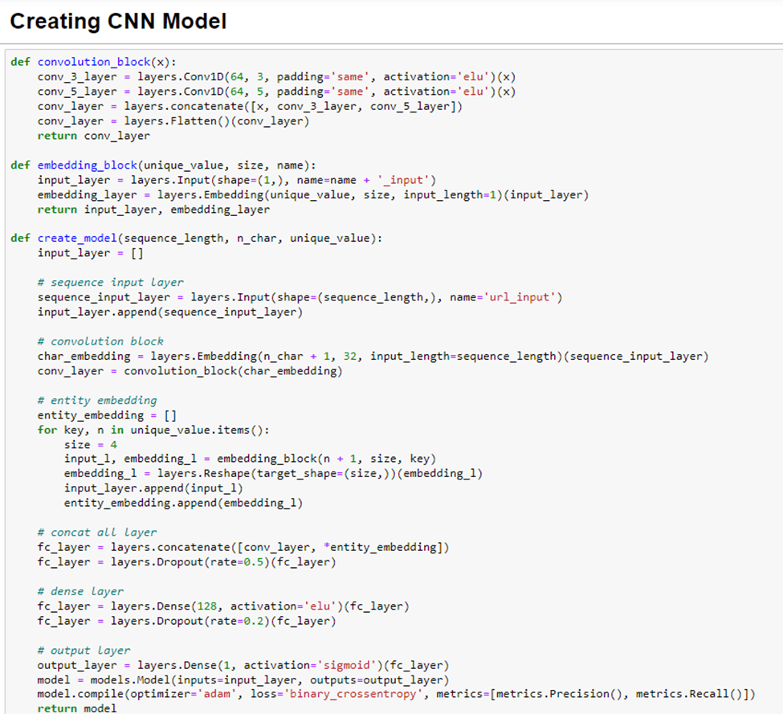

Slide 43
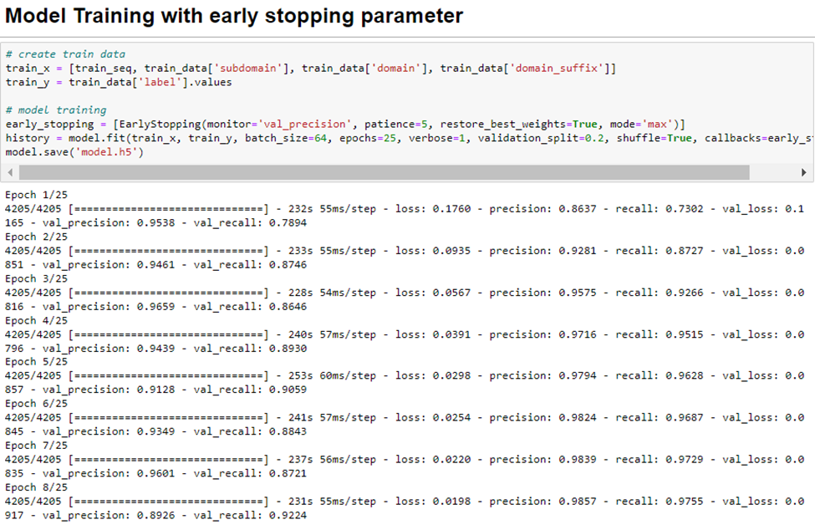

Slide 44
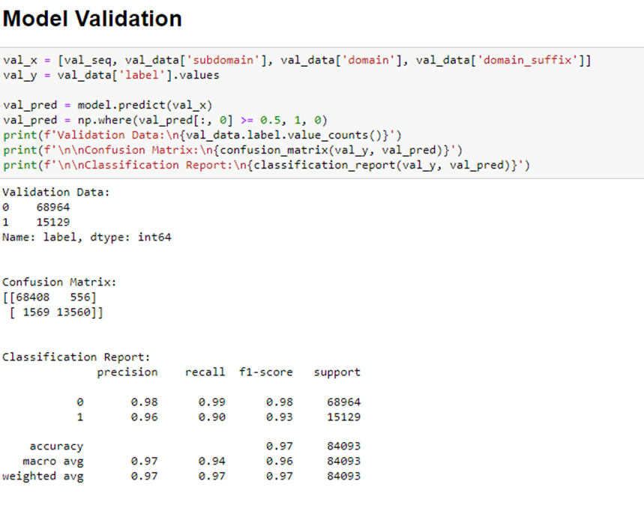

Slide 45
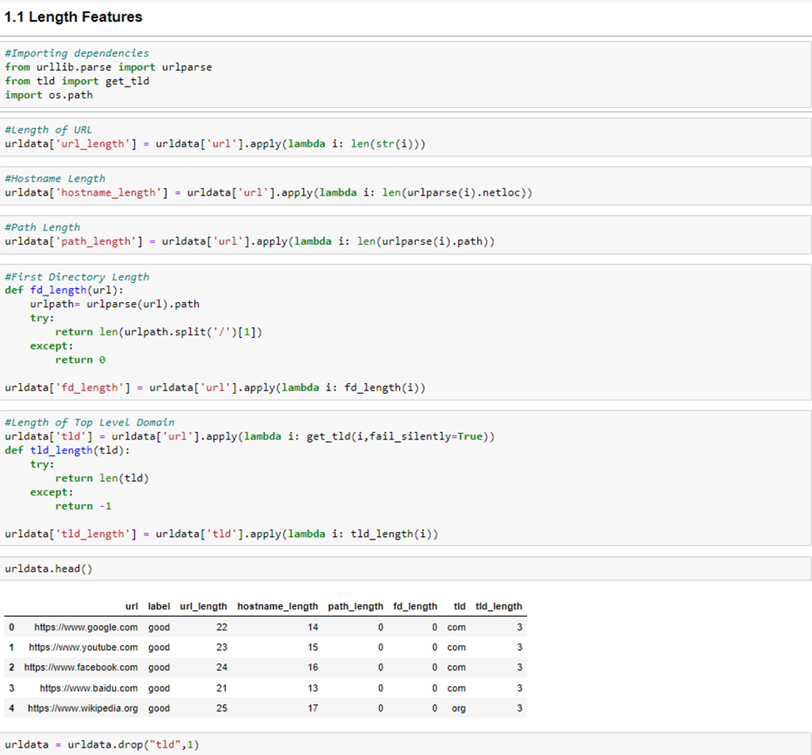

Slide 46
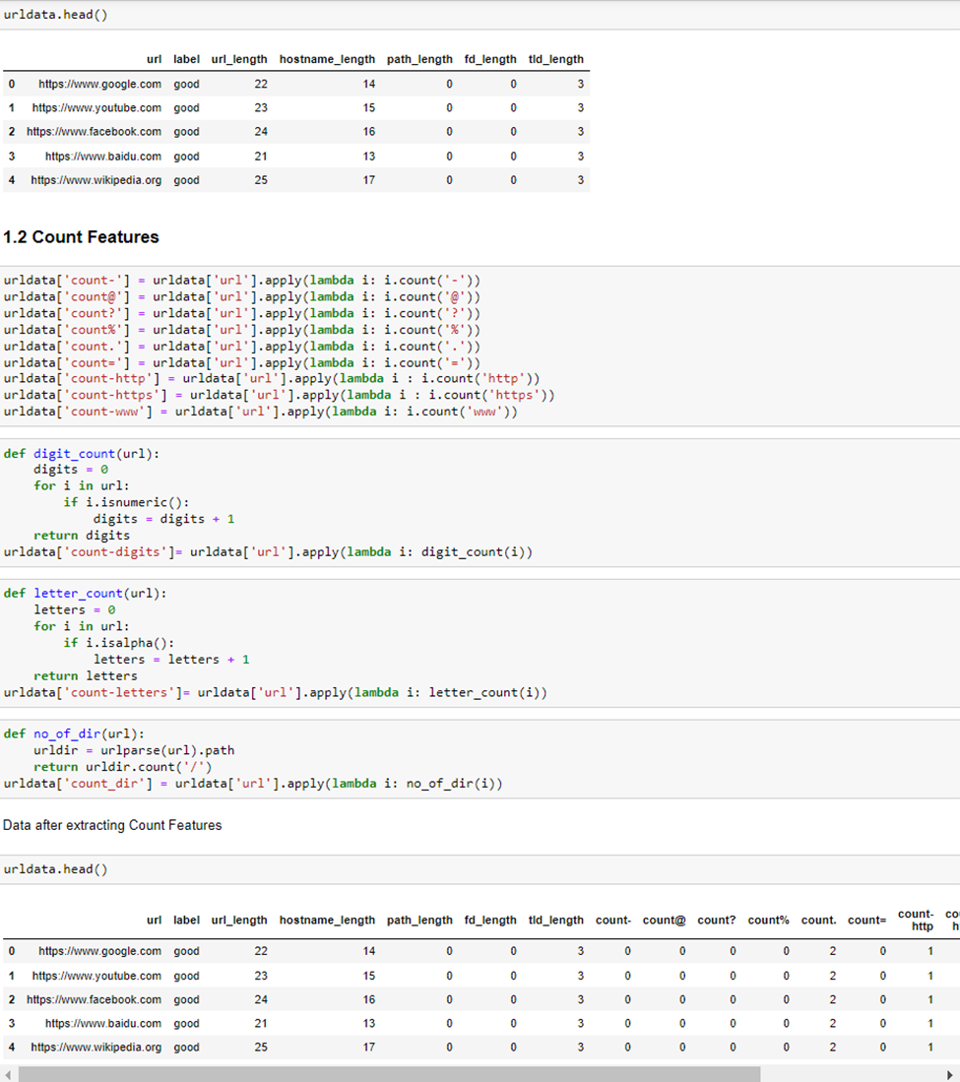

Slide 47
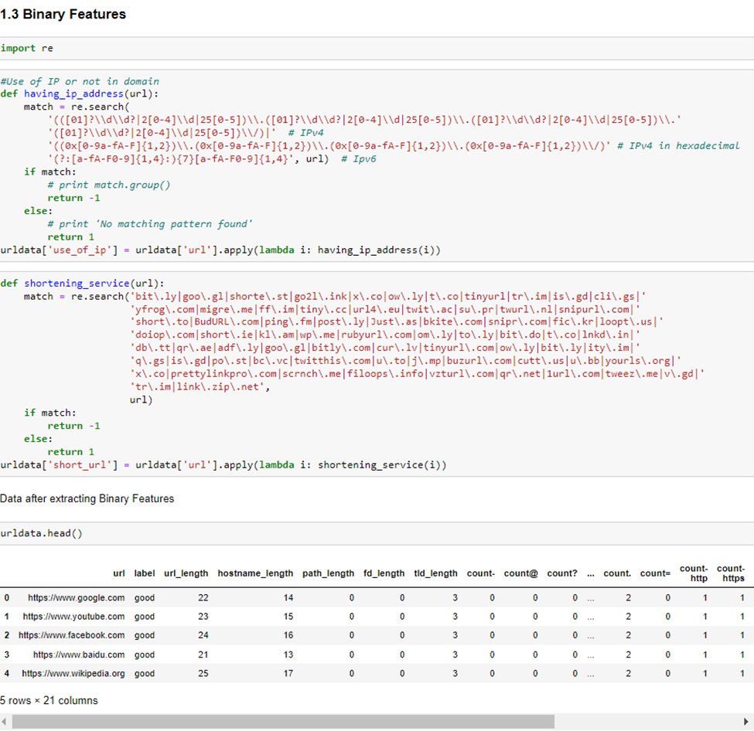

Slide 48
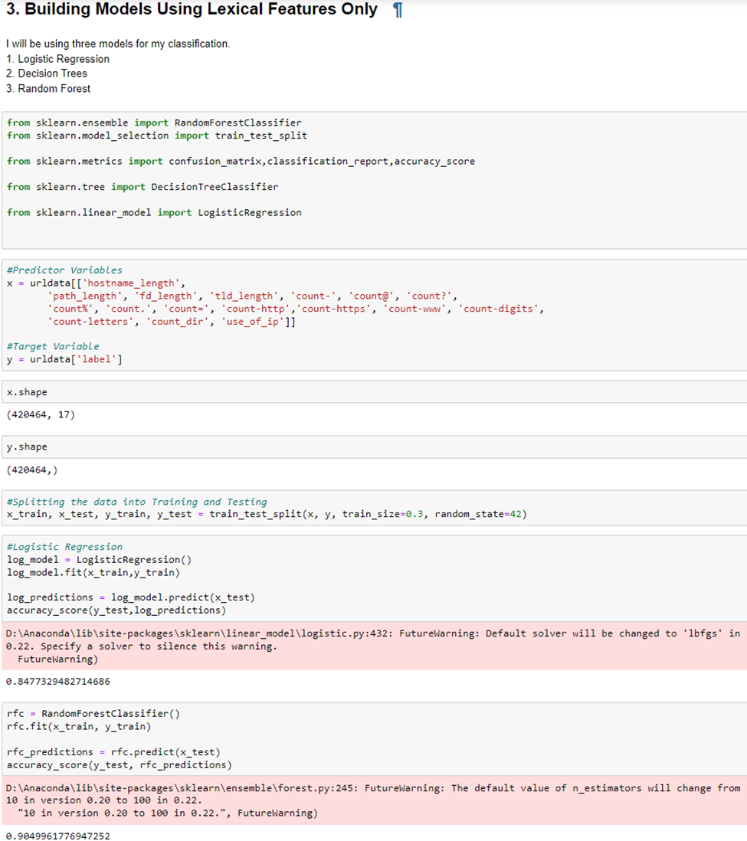

Slide 49
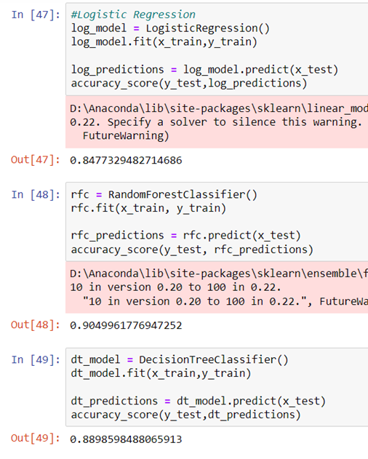

Slide 50
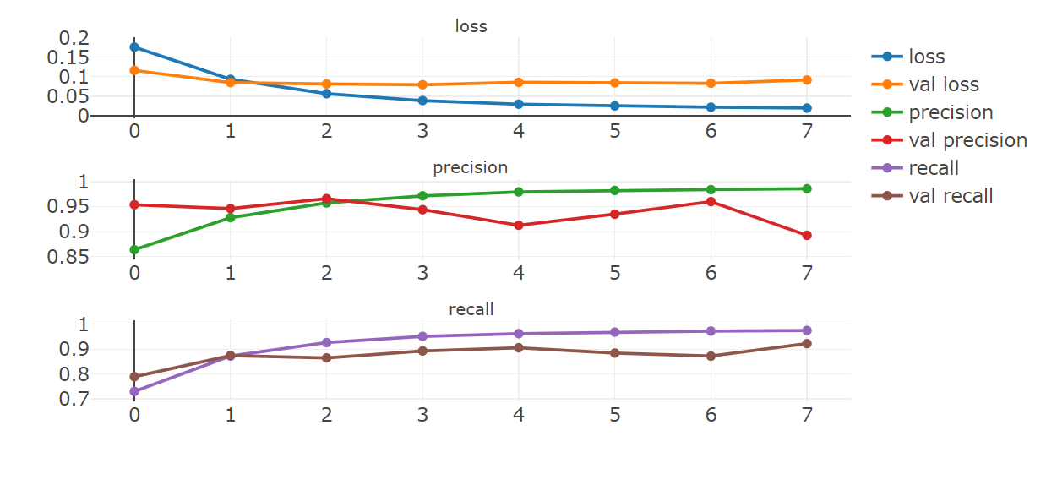
Implementation

Slide 51
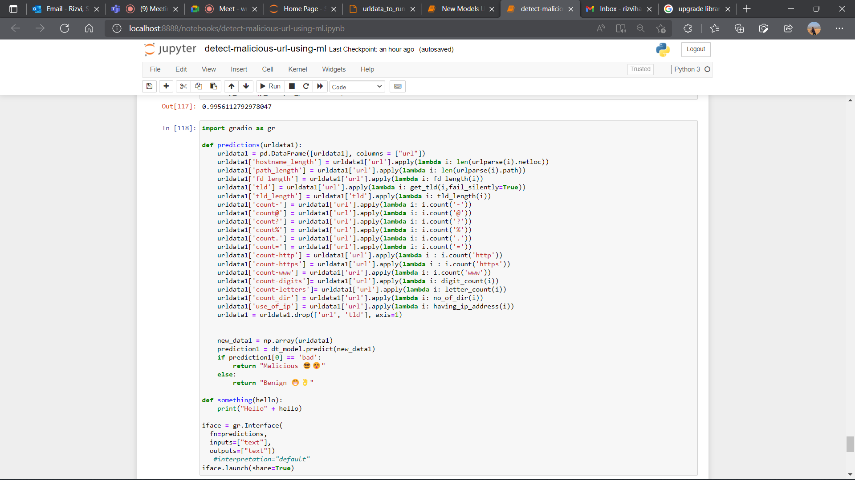
Implementation For Fusion System
Utilizing the Url vectors and Url features we convert the given user data and perform data engineering on it.

Slide 52
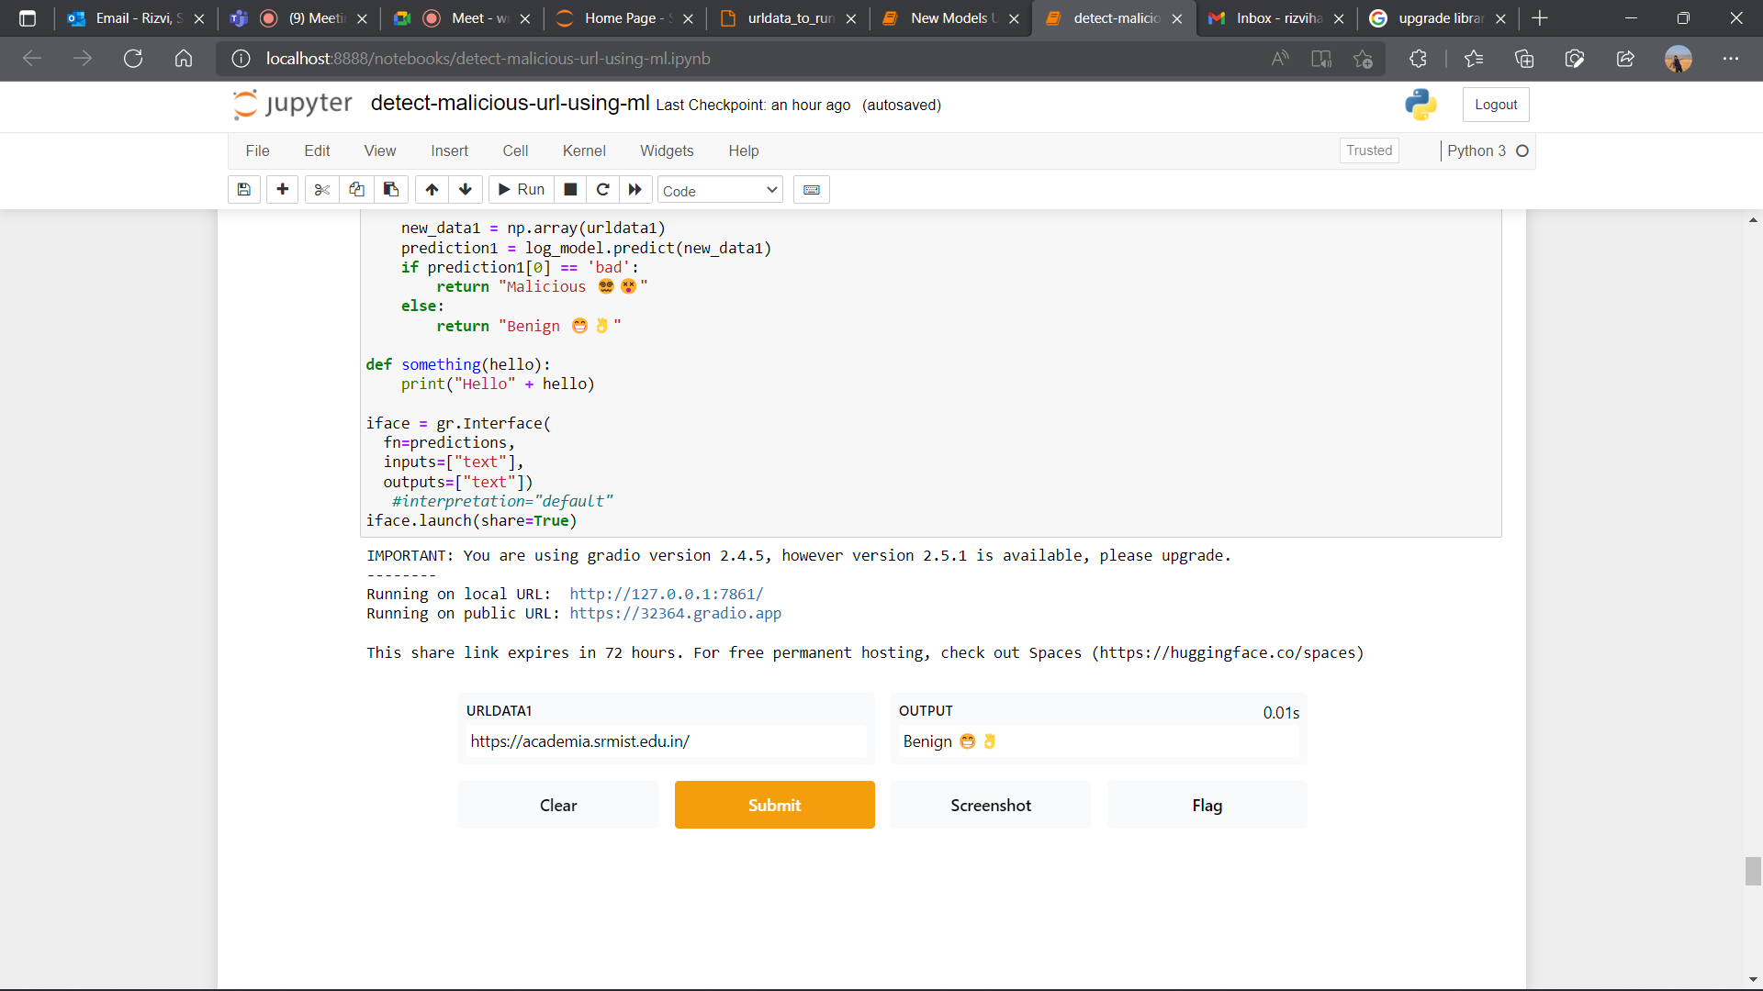
We are using gradio module in python to host a website and we take the input data and perform data engineering, then as the model predicts a value we display it on the page.

Slide 53
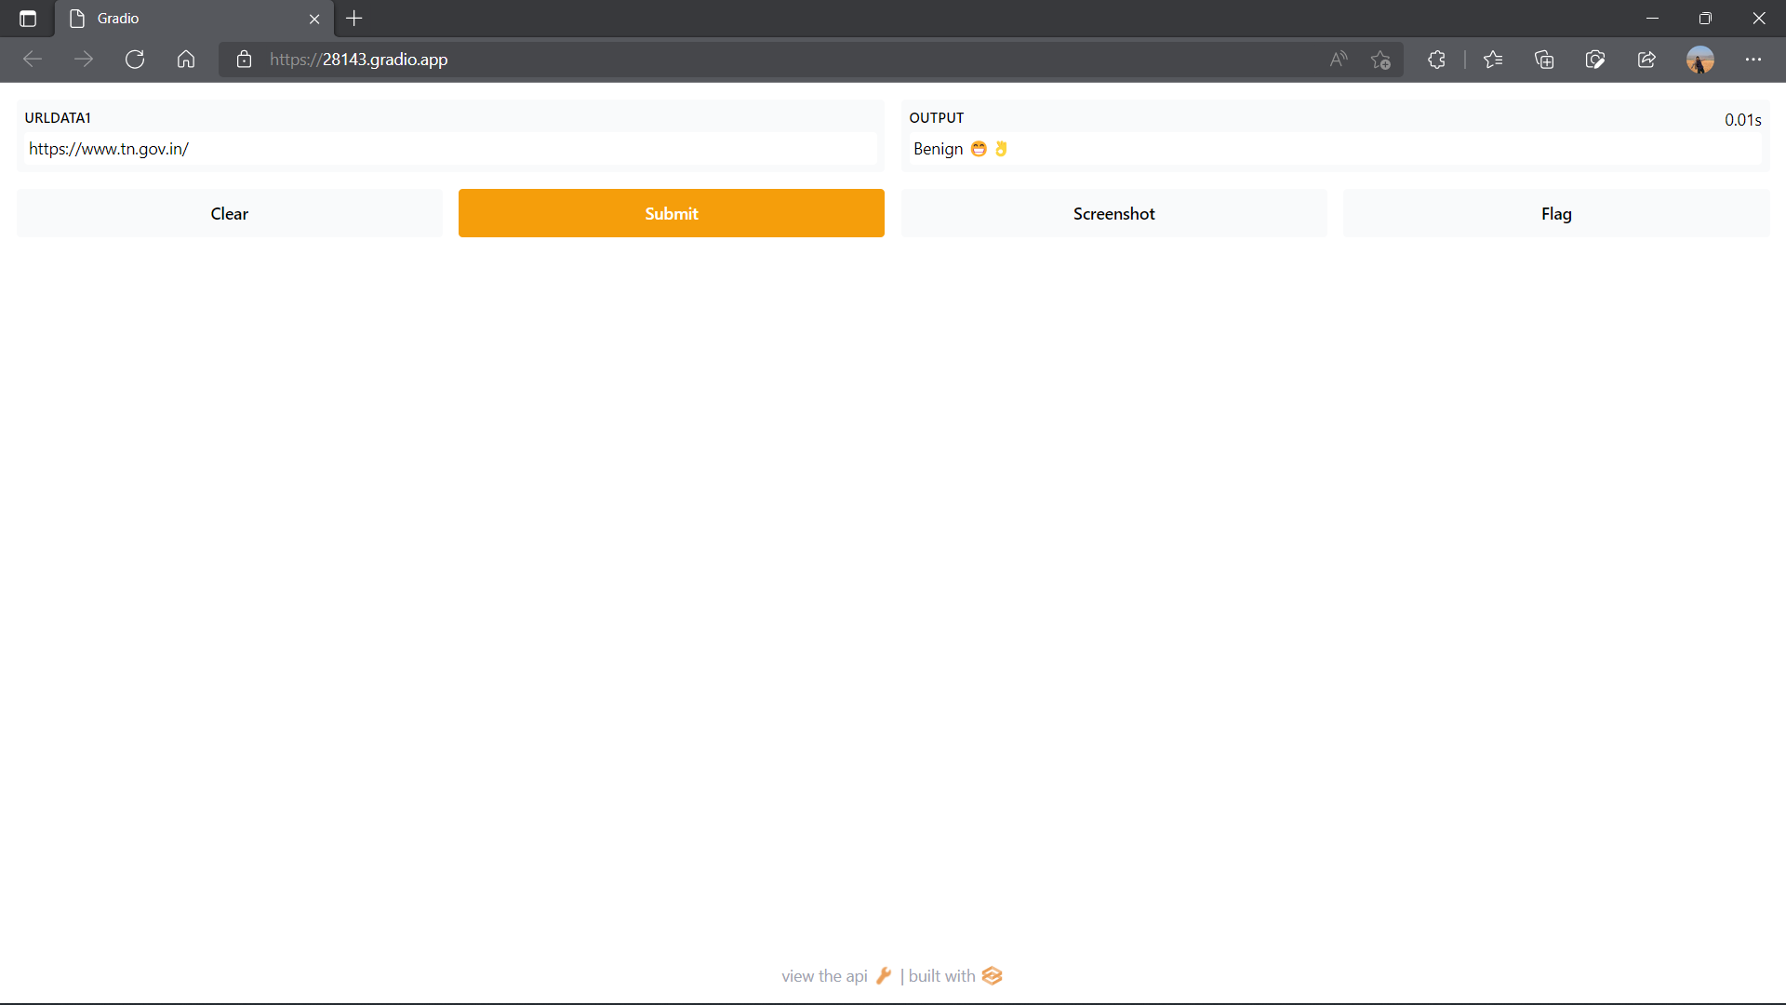
We can even create a remote link which anyone can access while our python notebook is running. All you need to do is copy the website link and give it a go.

Slide 54
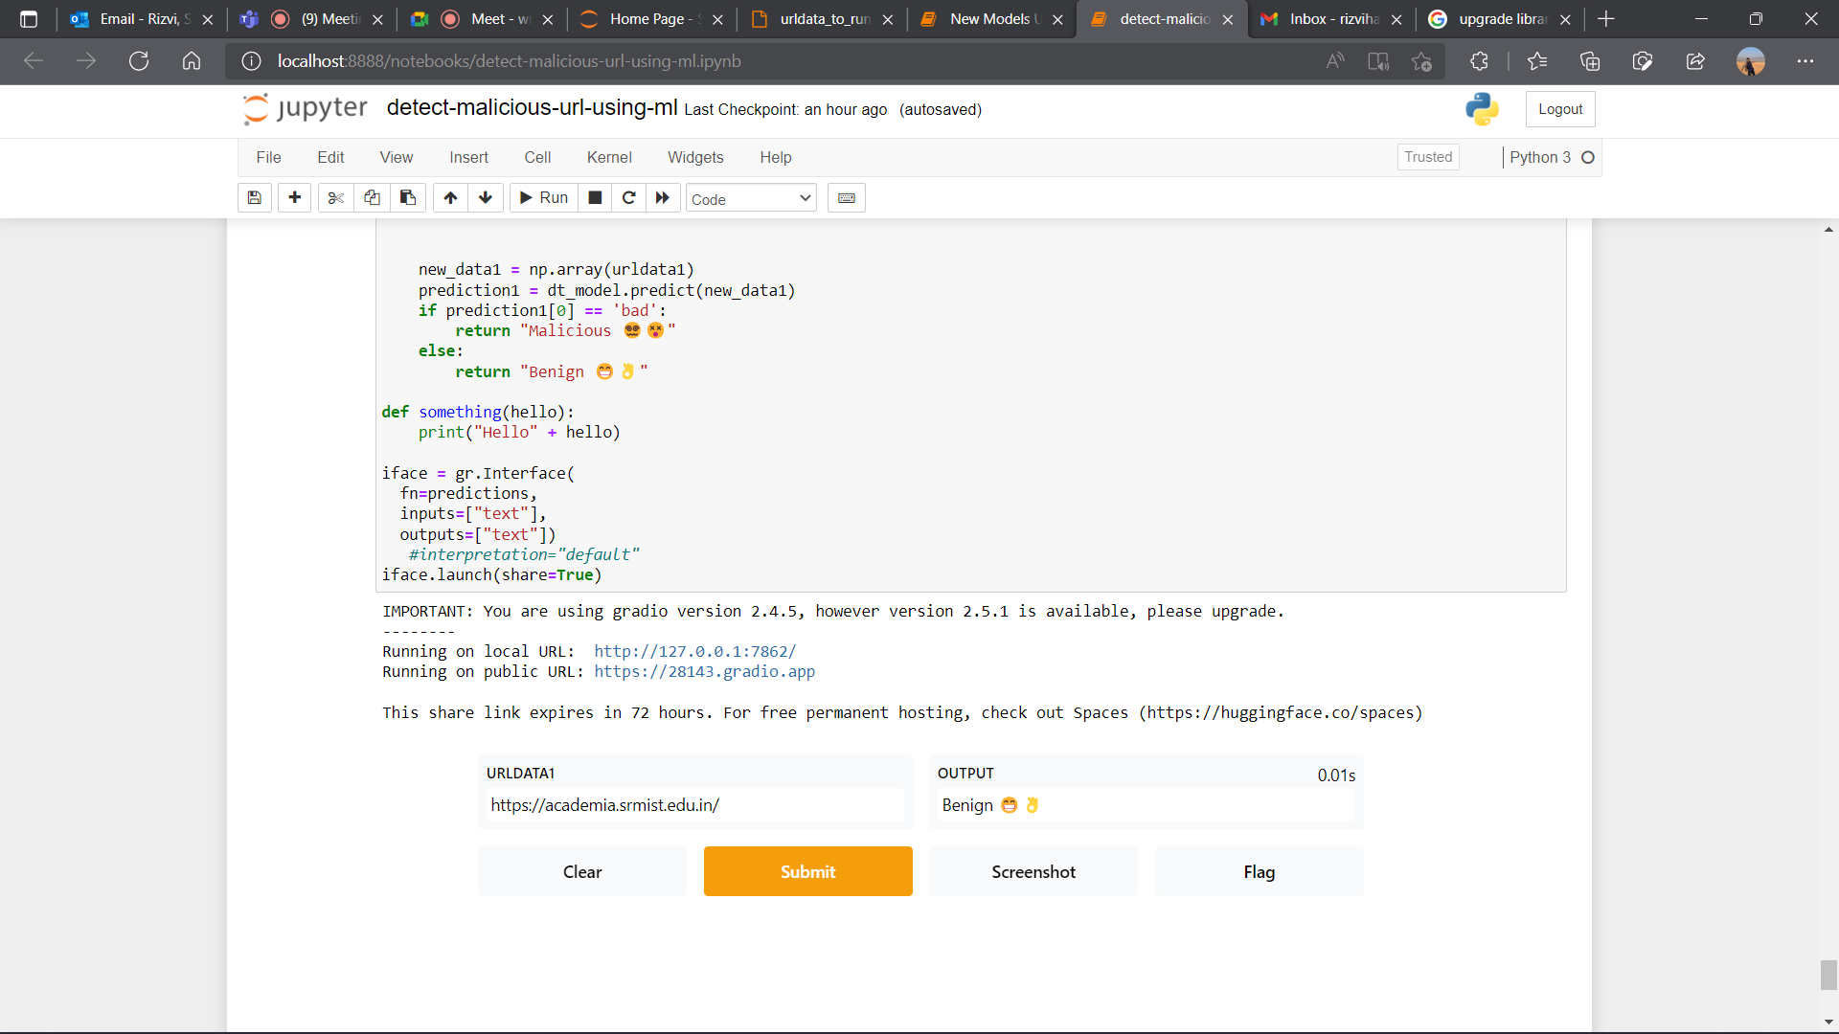

Slide 55
Final Review implementation
Incorporating a voting system, to combine these algorithms and generate results basis on the majority owing to less time boundedness after eventual training. Also this model can be trained at the end of every day and further improved.(Code on the next slide).

Slide 56
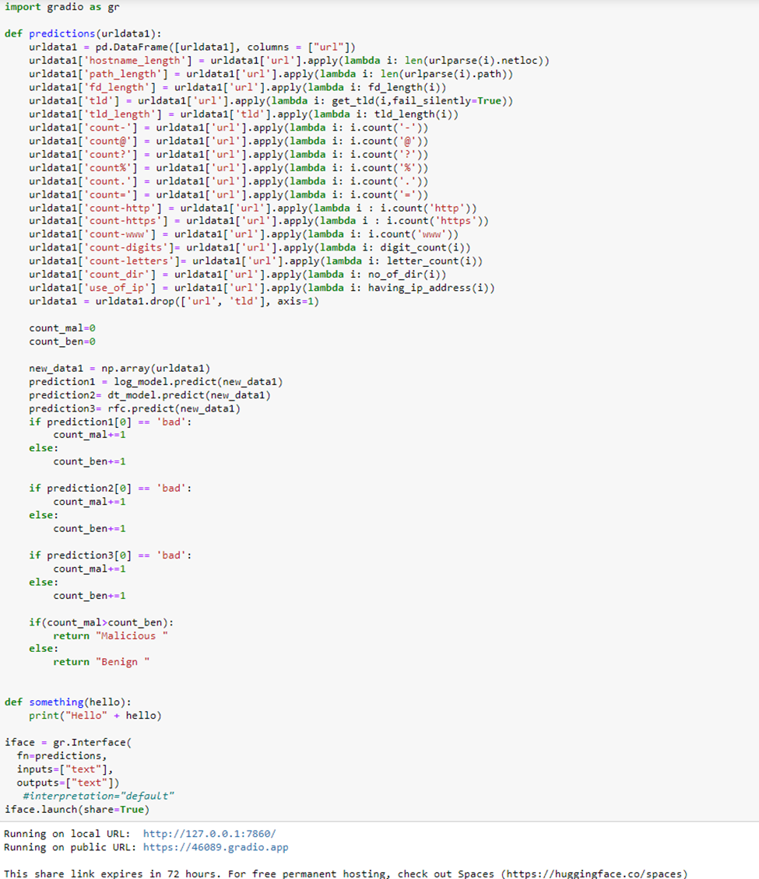

Slide 57
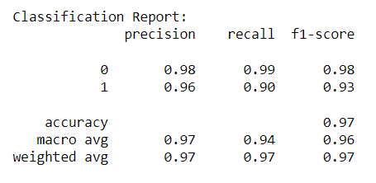
Results
In this paper, we have studied various methods for the evaluation of websites and their classification as malicious or benign.
We have used a way
The comparison that has been done here is between a convoluted neural network to detect malicious URLs and URL vectors to detect malicious internet addresses present in the database. Two different databases were utilised to get the results.
The convoluted neural networks had the following output -

Slide 58
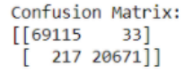
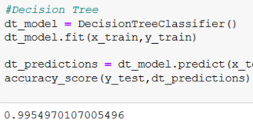
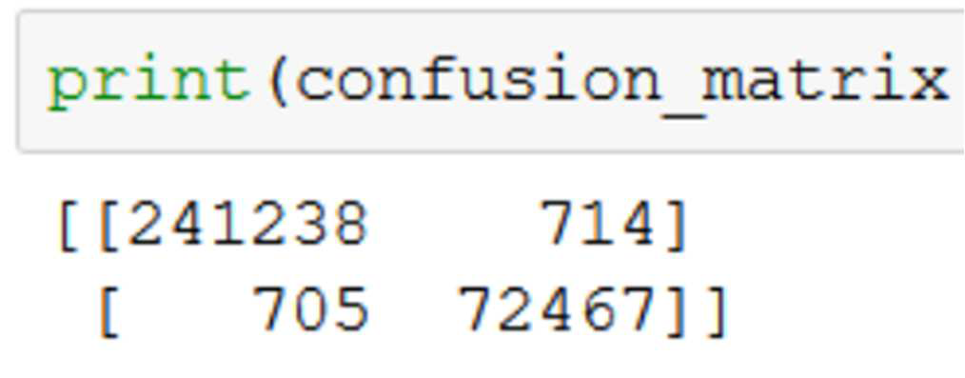
As it is evident from the classification report that the CNN model provides us with great accuracy. Also looking at the confusion matrix the false prediction for both the positive and negative values is low as compared to the correct predictions.
Now, coming to the URL vectors, the output received are as follows -
The accuracy achieved here using the URL vectors is quite similar to the one received with the CNN model but the confusion matrix can be seen as being not as good as the one seen in CNN.

Slide 59
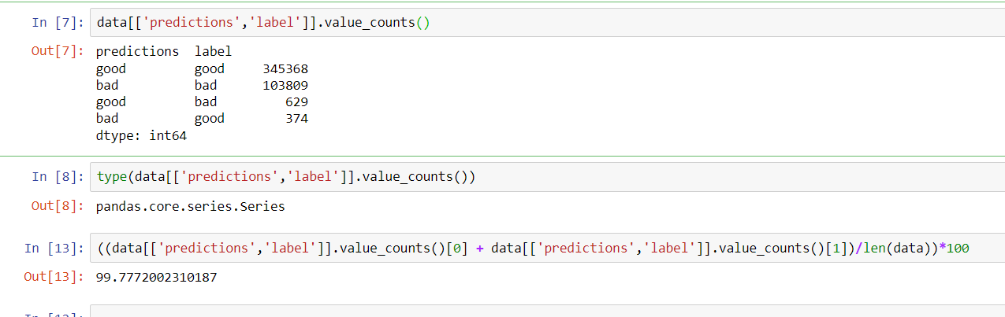
With our proposed voting algorithm model we observe an increase in Accuracy by almost 2% because the prediction is done on a combined basis of 3 algorithms. This is better than CNN and even promises a better confusion matrix.

Slide 60
References
[1]. https://www.vircom.com/blog/what-is-a-malicious-url/ - Joey Tanny
[2]. https://purplesec.us/resources/cyber-security-statistics/ -Jason, Purplesec author
[3]. Vazhayil, Anu & Ravi, Vinayakumar & Kp, Soman. (2018). Comparative Study of the
Detection of Malicious URLs Using Shallow and Deep Networks. 1-6.
10.1109/ICCCNT.2018.8494159.
[4]. B. Liang, J. Huang, F. Liu, D. Wang, D. Dong, and Z. Liang, “Maliciousweb pages detection
based on abnormal visibility recognition,” in E-Business and Information System Security, 2009.
EBISS’09. Interna-tional Conference on. IEEE, 2009, pp. 1–5.

Slide 61
References
[5]. A. Crisan, G. Florea, L. Halasz, C. Lemnaru, and C. Oprisa, “Detecting malicious URLs based
on machine learning algorithms and word embeddings,” in Proceedings of the 2020 IEEE 16th
International Conference on Intelligent Computer Communication and Processing (ICCP), pp.
187–193, IEEE, Cluj-Napoca, Romania, September 2020.
[6] S. Tiwari, H. Rizvi and K. Kalaiselvi, "Malicious Website Navigation Prevention Using CNNs
and URL Vectors: A Study," 2022 International Conference on Computer Communication and
Informatics (ICCCI), 2022, pp. 1-6, doi: 10.1109/ICCCI54379.2022.9741056

Slide 62
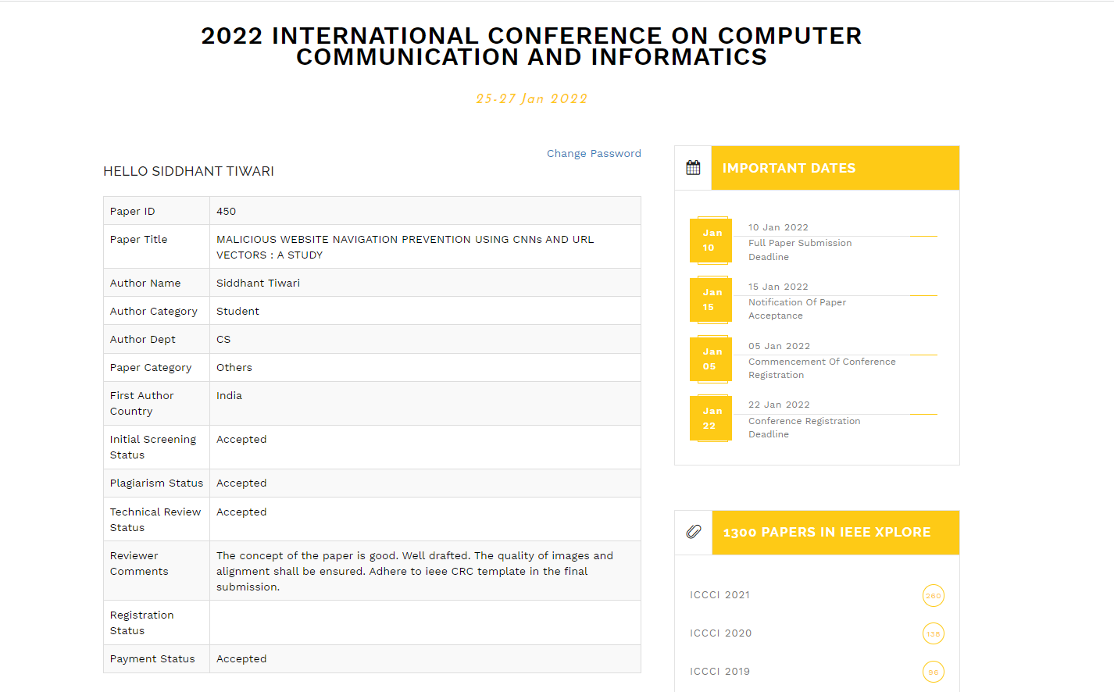
Paper Submission proof
Paper submitted to ICCCI an IEEE conference(http://iccci.in/)

Slide 63
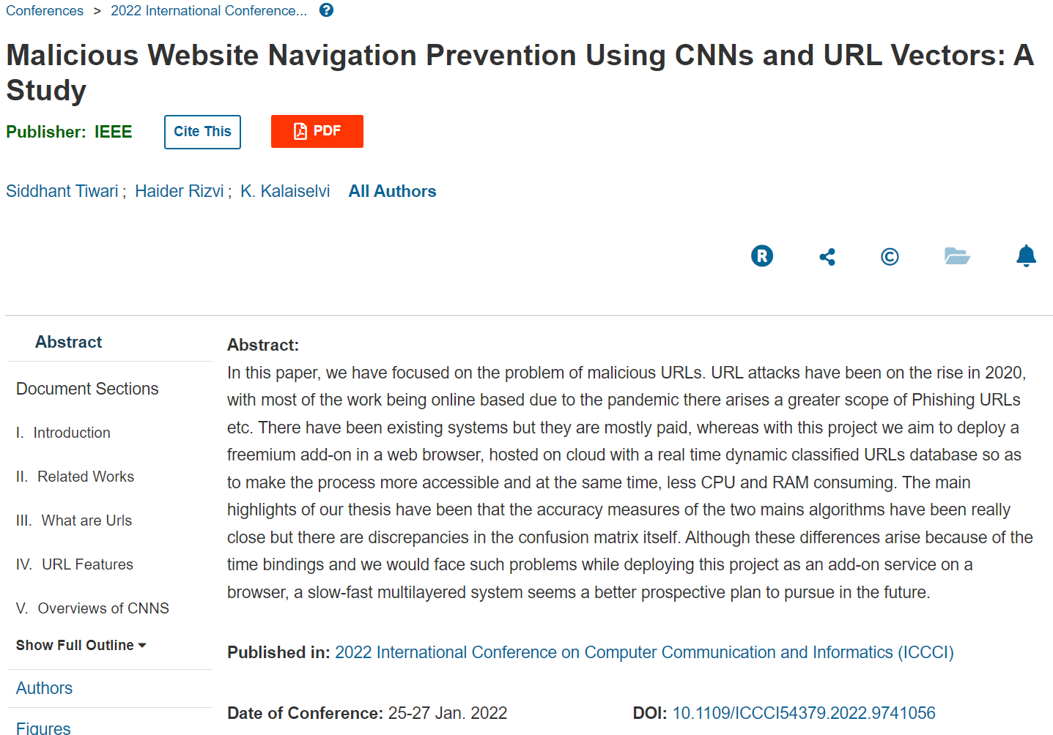
List of Publications

Slide 64
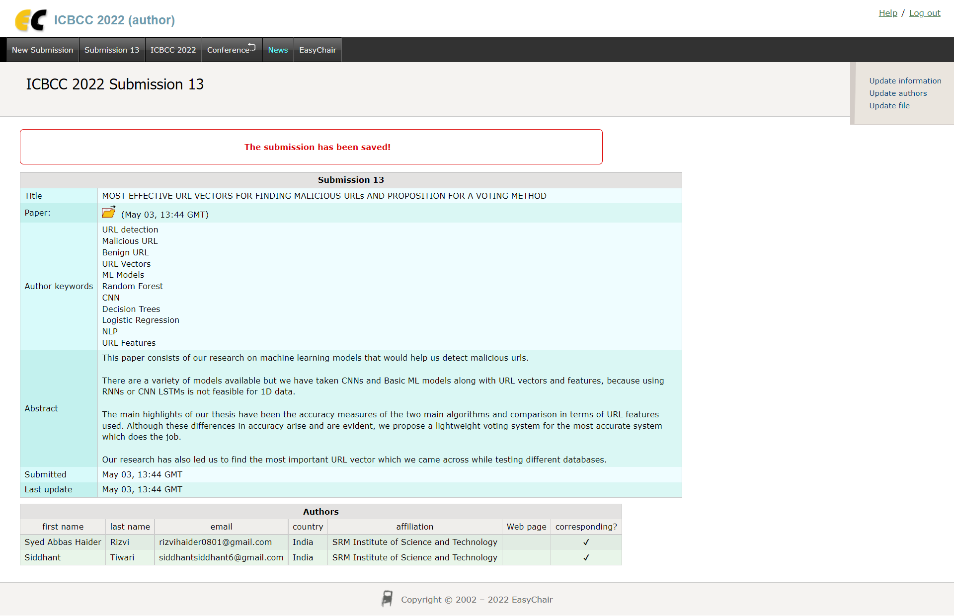
Paper Submission proof
ICBCC 2022 Submission

Slide 65
THANK
YOU

